Slide 1
From Beginning to End: An Overview of Systems Analysis and Design
Chapter 1
Systems Analysis and Design in a Changing World 7th Ed
Satzinger, Jackson & Burd

Slide 2
Software Development
Computer application (app) – a computer software program that executes on a computing device to carry out a specific set of functions
Information system – a set of interrelated components that collects, processes, stores, and provides an output the information needed to complete business tasks
Broader in scope than “app”
Includes database and related manual (include people) processes

Slide 3
Software Development
Systems analysis – those activities that enable a person to understand and specify what an information system should accomplish.
Ex: a customer management system must track customers, register products, and many other functions-all of which have many details.
Systems design – those activities that enable a person to define and describe in detail how the information system will actually be implemented to provide the needed solution.

Slide 4
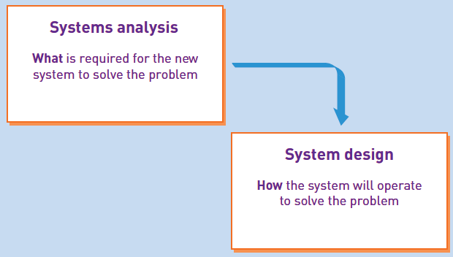

Slide 5
Example
Suppose an owner of the land who has the vision, the builder who will construct the building, and the architect who serves as the bridge between the owner and the builder.
The architect helps the owner develop the vision but must also communicate the building’s specifications to the builder.
In doing so, the architect uses various tools to first capture the vision from the owner and to then provide the builder with instructions-including line drawings, blueprints, to-scale models …
Just as builders, programmers don't just sit down and start writing program code. They need someone (systems analyst) to function like an architect-planning, understanding details, specifying needs-before designing and writing the code that satisfies the vision.

Slide 6
System Development Life Cycle (SDLC)
Is a framework that identifies all activities required to build, launch, and maintain an information system (Called Project).
Normally, the SDLC includes all ac­tivities needed for the planning, systems analysis, systems design, programming, testing, and user training stages, as well as other project management
Six core processes are:
Identify the problem or need and obtain approval
Plan and monitor the project
Discover and understand the details of the problem or need
Design the system components that solve the problem
Build, test, and integrate system components
Complete system tests and then deploy the solution

Slide 7
Systems Development Life Cycle (SDLC)
Initial development of a new information system is usually done as a project.
Project – a planned undertaking that has a beginning and end and that produces some definite result
Used to develop an information system
Requires knowledge of systems analysis and systems design tools and techniques

Slide 8
System Development Life Cycle (SDLC)
System development process – the actual approach used to develop a particular information system (aka: methodology)
Most processes/methodologies now use Agile and Iterative development
Notes:
Also known as

Slide 9
Iterative Development
Agile development – an information system development process that emphasizes flexibility to anticipate new requirements during development.
It aims to reduce massive planning overhead to allow fast reactions to change
So it is fast; responsive to change
Iterative development -- an approach to system development in which the system is “grown” piece by piece through multiple iterations (code>get feedback>code> …..)
Complete small part of system (mini-project), then repeat processes to refine and add more, then repeat to refine and add more, until done

Slide 10
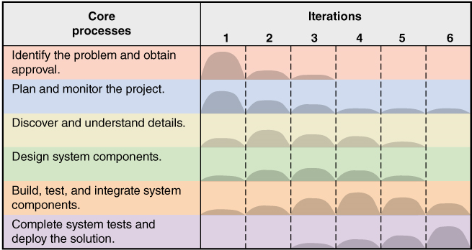
Iterative and Agile Systems Development Lifecycle (SDLC)

Slide 11
The six core processes of the SDLC showing iterations
The figure illustrates how an iterative project might be managed.
There are six iterations as columns. Each iteration involves all six core processes, shown as rows in the table.
At the end of each iteration, a working part of the system is completed and evaluated. An iteration lasts a fixed period of time, usually two to four weeks.
The rounded mounds inside the graph represent the relative amount of effort. For example, Iteration 1 appears to primarily focus on identifying the problem and planning the project.

Slide 12
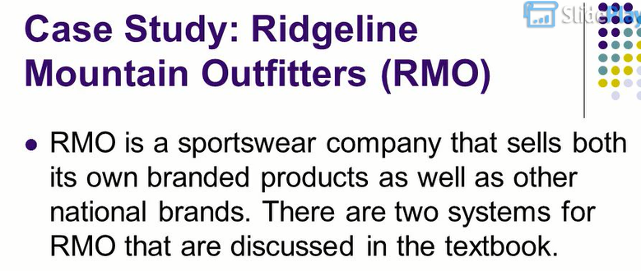
Example: RMO Tradeshow System

Slide 13
Example: RMO Tradeshow System
Sample project for chapter
Problem-- purchasing agents attend apparel and fabric trade shows around the world to order new products from suppliers
Need– information system (app) to collect and track information about suppliers and new products while at tradeshows
Tradeshow Project– is proposed
Supplier information subsystem
Product information subsystem

Slide 14
Initial Activities – Pre-project
Identify the problem and document the objective of the system (core process 1)
Preliminary investigation
System Vision Document
Obtain approval to commence the project (core process 1)
Meet with key stakeholders, including executive management
Decision reached, approve plan and budget

Slide 15
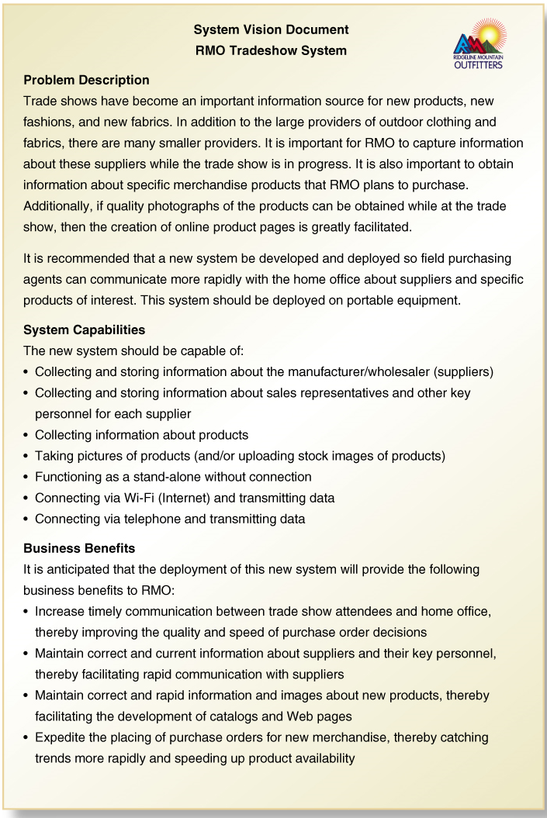
System Vision Document
Problem description System capabilities Business benefits

Slide 16
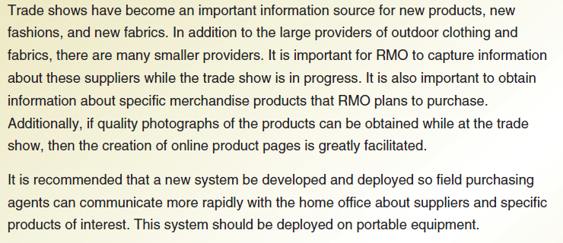
Problem Description

